Slide 1
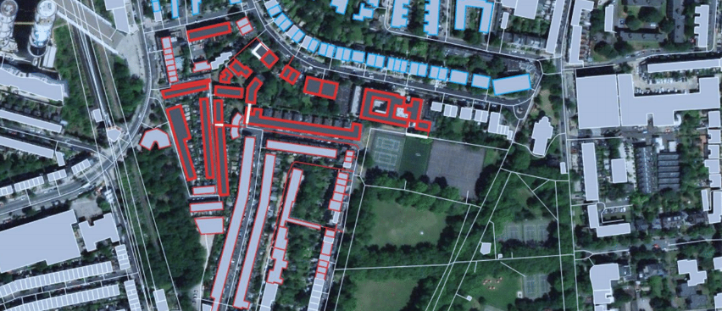
Better planning for better results
Thermal Energy Planning Software
Fast and cost-effective low-carbon district heating and cooling systems

Slide 2
Developed with:
Funded by:
Notes:
Who is THERMOS?

Slide 3
THERMOS Software Pitchbook 2020
Why district heating and cooling planning?
Challenges for affordable DHC planning today
Identifying user optimal DHC solutions with THERMOS
Obtaining the THERMOS tool for your work
User experiences
Access THERMOS

Slide 4
Why District Heating and Cooling?
Picture: eorgeclerk - istock

Slide 5
District heating and cooling (DHC) is
now in the core of global climate action
Sustainable Development Goals – SDG7
Covenant of Mayors of Climate and Energy
EU Clean Energy for all Europeans Package
Paris Agreement
Kigali Amendment of the Montreal Protocol
EU Green Deal & Local Green Deals,
Renovation Wave
Global action
Local Action
Notes:
Paris Agreement:
SDGs especially, SDG 7 defines the importance of Sustainable Energy for all, highlighting the importance or having sustainable energy for all. (SD7)
EU’s commitment to the Paris Agreement, requires regions and cities to reduce annual GHG emissions by 40% by the year 2030 (compared with 1990 levels) and by at least 80% by 2050. Efficient planning and upgrade of district heating and cooling systems is key to achieve local and national climate goals
Kigali Ammendment: District cooling networks will faciliate a fast and cost-effective transition to sustainable refrigerants compliant with the Kigali Amendment to the Montreal Protocol within cooling systems on residential and industrial level. The Amendment will phase-down HFCs under the Montreal Protocol. Use of HFCs is increasing rapidly as substitutes for ozone-depleting substances. HFC phasedown is expected to prevent the emission of up to 105 million tonnes of carbon dioxide equivalent of greenhouse gases, helping to avoid up to 0.5 degree Celsius of global temperature rise by 2100, while continuing to protect the ozone layer.
Cities, signatories of the Covenant of Mayors on Climate and Energy should develop and implement sustainable energy and climate action plans (SECAPs), where district heating and cooling play an important role on cities mitigation efforts.
EU (and local) GREEN DEAL(s)

Slide 6
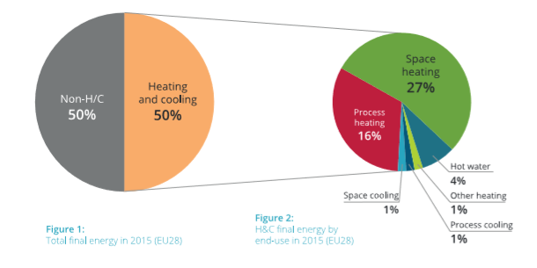
Half of Europe´s energy is consumed for heating and cooling purposes
Most of this thermal energy is used in buildings and industries, located in cities
Decarbonisation in buildings and industry hold the key to Europe´s energy transition towards a sustainable low carbon future
Source: Heat Roadmap Europe, 2017
Notes:
Combined HC represent the largest energy sector today. By redesigning energy systems in Europe even with using only proven and market available technologies, it is possible to combine end-use savings with heat pumps and DHC using excess heat, efficiency and renewable sources to meet the 1,5 -2°C temperature increase target.
In numbers: CO2emissions can be reduced by 4.340M ton or 86% compared to 1990 with existing technology in the HC sector.
*Numbers researched for the 14 countries representing 90% of the European heat market: AT, BE, CZ, DE, ES, FI, FR, HU, IT, NL, PL, RO, SE, UK,
Source: Heat Roadmap Europe

Slide 7
District heating is central for a sustainable local energy transition
District heating has the potential to cost-effectively provide for at least half of the heating demand by 2050;
District heating is the most economic and technically viable solution for the majority of urban areas;
Expansion of thermal grids is crucial to enhance grid flexibility & integrate increasing shares of Renewable energy systems (RES)
Source: Heat Roadmap Europe, 2017
Notes:
District energy systems are increasingly climate resilient and low-carbon, allowing:
- up to 50 per cent less primary energy consumption for heating and cooling;
- the recovery and distribution of surplus and low-grade heat and cold to end-users (e.g. waste heat from industry, power stations, waste incinerators and sewage treatment or cooling from water bodies and even LNG terminals);
- the storage of large amounts of energy at low cost – for example, solar heat for use during winter or conversion of surplus renewable power into heating or cooling for use during peak thermal demand;
- the integration and balancing of large shares of variable renewable power on electricity grids through thermal storage, cogeneration and heat pumps;
a fast and cost-effective transition to sustainable refrigerants compliant with the Kigali Amendment to the Montreal Protocol.

Slide 8
District cooling: a new challenge in a changing climate
The use of energy for space cooling is growing faster than any other end use in buildings, more than tripling between 1990 and 2016.
Rising demand for space cooling is already impacting electricity systems in many countries, as well as driving up emissions.
Source: International Energy Agency, 2019 The Future of Cooling Opportunities for energy- efficient air conditioning

Slide 9
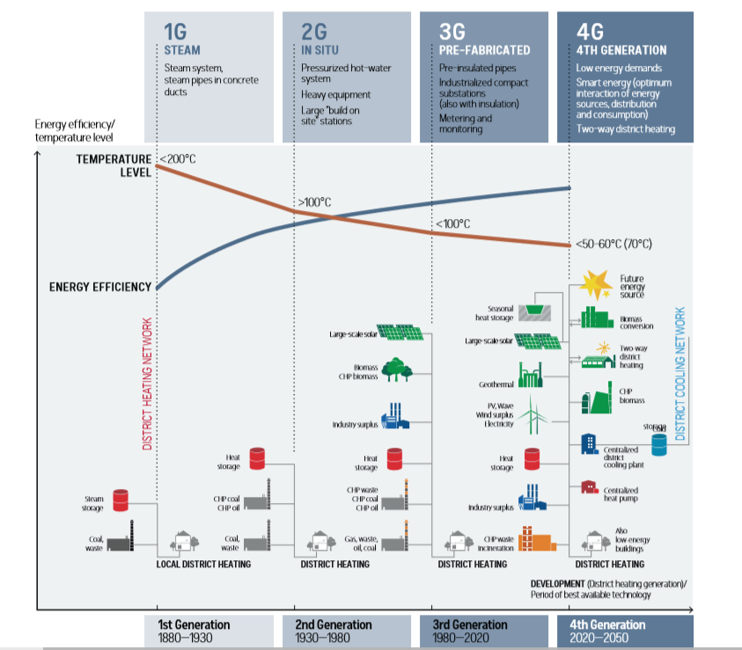
The future of DHC: Low-carbon & climate resilient
DHC systems can deliver higher security of supply, lower costs and lower CO2 emissions.
DHC systems must be effectively planned and key technological innovations introduced where needed.
The full potential of modern DHC systems remains untapped and can be fully exploited on a local level.
Source. University of Aalborg. District Energy Report UNEP & ICLEI 2015.; (2) Wener. 2017. International review of district heating and cooling.

Slide 10
Sustainability benefits of DHC systems for cities & citizens
Greenhouse Gas (GHG) Emission Reductions
Air Quality Improvements
Energy Efficiency Improvements
Use of Local and Renewable Sources
Resiliency and Energy Access
Green economy (job creation, investments, energy price reduction for households)
Picture: mbbirdy - istock
Source: UNEP. District Energy in Cities. Unlocking the Potential of Energy Efficiency and Renewable Energy, Report. 2015.
Notes:
GREENHOUSE GAS EMISSION REDUCTIONS: Rapid, deep and cost-effective emissions reductions, due to fuel switching and to decreases in primary energy consumption of 30–50 per cent (e.g., the district cooling network in Paris uses 50 per cent less primary energy).
AIR QUALITY IMPROVEMENTS: Reduced indoor and outdoor air pollution and their associated health impacts, through reduced fossil fuel consumption.
ENERGY EFFICIENCY IMPROVEMENTS: Operational efficiency gains of up to 90 per cent through use of district energy infrastructure to link the heat and electricity sectors (e.g., Helsinki’s CHP plants often operate at 93 per cent primary energy efficiency).
USE OF LOCAL AND RENEWABLE RESOURCES: Harnessing of local energy sources, including from waste streams, reject heat, natural water bodies and renewable energy. Piloting of new technologies, such as thermal storage, to integrate variable renewables.
RESILIENCE AND ENERGY ACCESS: Reduced import dependency and fossil fuel price volatility. Management of electricity demand and reduced risk of brownouts.
GREEN ECONOMY: Cost savings from avoided or deferred investment in generation infrastructure and peak power capacity. Wealth creation through reduced fossil fuel bills and generation of local tax revenue. Employment from jobs created in system design, construction, equipment manufacturing, operation and maintenance.

Slide 11
Key challenges for rolling out DHC solutions today
Picture: Matthias Naumann -Alamy Stock Photo
Notes:
Whats keeping energy planners and local authorities from rolling out DHC solutions?

Slide 12
Challenges for DHC system planning today
Planning processes for district heating and cooling networks is resource-demanding and requires further alignment with local energy and climate reduction goals.
Lack of data on energy demand on a local level and/or building level delaying planning processes
Infinite amount of possible new network routes requiring a time and resource intensive process often leading to non-optimal solutions
High level of expertise needed by staff often requires costly outsourcing of planning processes
Upfront costs for DHC network planning are usually high particularly if repeat or iterative analysis is required
Notes:
What is missing/ challenging? What are common problems for energy planners? Open up to audience:
Planning the development of a district heating and cooling (DHC) network is complex and local authorities often do not have the capacity to carry out their own feasibility work in-house. This means that the process can be expensive and time consuming, and may also lack transparency, as well as taking into account energy targets of cities.
High level of expertise needed by staff often requires costly outsourcing of planning processes”
“Upfront costs for DHC network planning are usually high, particularly if repeat or iterative analysis is required

Slide 13
THERMOS -
A tool to accelerate an affordable energy transition
Picture: Drazen Lovric - istock

Slide 14
THERMOS - an open-source software designed to identify your optimal solution
Informed & Reliable– solid data on energy demand and available sources ready at hand!
Brief & Easy – transforming the data at hand into comprehensive pre-feasibility studies in a short timeframe
Targeted & Efficient – Context optimal results for a cost- and time effective use of budget, energy efficiency and renwwable energy potential and existing infrastructure
Enabling & Proactive – Building up in-house capacity with every project, independent of external consultancy
Notes:
THERMOS will enable public authorities and other stakeholders to undertake more sophisticated thermal energy system planning far more rapidly and cheaply than they can today. This will amplify and accelerate the development of new low carbon heating and cooling systems across Europe, and enable faster upgrade, refurbishment and expansion of existing systems. Specifically, THERMOS aims to put local decision makers in a position where they are able to identify the right areas and routes for different types of thermal system quickly and accurately by automating questions about possible system configurations and economics.

Slide 15
Optimal solutions for 4 key scenarios
THERMOS is designed around four main scenarios of thermal network planning solutions.
Expansion of existing district heating and cooling networks by identifying which buildings, streets or neighbourhoods to connect to the network
Identifying local energy demands for known energy sources and finding the best route for the pipework
Optimal network solution to link available energy sources with known demand
Singling out optimal solution for energy demand reduction and by comparing network vs no network options
1
2
3
4
Notes:
THERMOS sets capital costs for plant, pipes and connections against revenues from heat sales and monetised greenhouse gases (GHG) emissions
THERMOS facilitates early-stage planning of district energy systems. Considers four main use-cases:
Expansion of existing district energy systems
Identifying local energy demands for known energy sources
Optimising networks between known energy sources and demands
Providing optimised solutions when considering energy demand reduction, networked and non-networked system measures. Where you wish to compare the performance assessment of potential DHC networks and non-DHC solutions

Slide 16
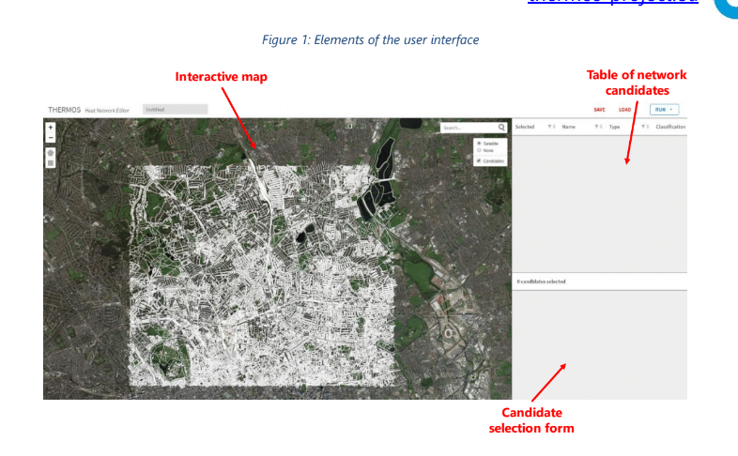
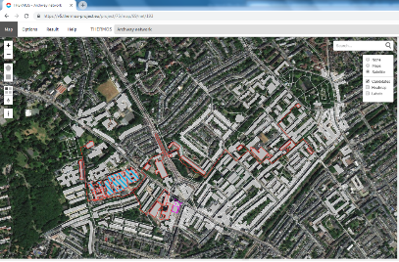
Energy Demand Mapping
Description
Instant high-resolution address-level mapping with an open-source application. THERMOS can be applied anywhere there is appropriate mapping data.
Key Features
Instant high-resolution address-level mapping with an open-source application;
Built-in energy demand estimations from OpenStreetMap (OSM) or local GIS data;
Maps can be created either automatically from OSM, or from your own shapefiles
Demand estimates can be calculated automatically based on 3D building geometries (assuming LIDAR or building height data is available), or you can upload or enter your own values
Rapid generation of local heat density maps
Optional in-map editing of infrastructure or heat demands;
Notes:
If no other data is available, the tool will estimate heat demands based on the shape of OSM building polygons and building type (residential or not), but in this case low accuracy may result. Accuracy will improve if building height data is available (can be entered within OSM or uploaded directly to the tool) or alternatively local LIDAR data can be uploaded to the tool. LIDAR (Light Detection and Ranging) is a technique which produces a digital surface model of the ground and will indicate the height of objects above a datum.
The best solution is to upload your own building demand data if known – this can be done by uploading a GIS file or values can be entered directly using the mapping page user interface.

Slide 17
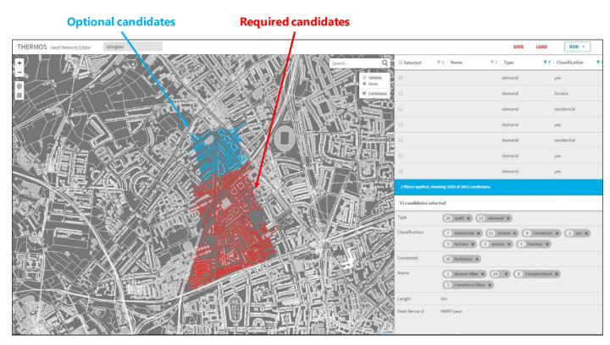
Energy system optimisation
Description
THERMOS computes optimal solutions for heating or cooling network layouts and energy supply options. It can find cost-optimal solutions by setting capital costs for plant, pipes and connections against revenues from heat sales and monetised GHG emissions.
Key Features
Configurable features of thermal networks
User-specification of energy supply plant, including heat demand profiles
Accessibility wherever, whenever for individuals or a team tasked with conducing a pre-feasibility analyses
User specification which buildings and routes are either allowed or required to be in the solution, and the location(s) at which heat supply can be provided
And it’s flexible. THERMOS’s network optimisation model can be adapted to user-specific network criteria.

Slide 18
Benefits of using THERMOS for energy planners
Integrating local (low-carbon) energy sources in local thermal networks.
Better network design on a prefeasibility stage
Accelerating transition towards local sustainability goals, such as energy, GHG emissions and air pollution reduction goals more easily and clearly
Enabling reduced energy costs and higher energy efficiency
Fostering innovation and collaboration among public and private sector
Notes:
Better network design at the prefeasibility stage – current practice does not identify optimal solutions
Significantly faster and cheaper assessment of options, allowing for many more options to be considered rapidly at greatly reduced cost
Simplified process and intuitive software interface
Freely available training material for self-training staff to use the software and obtaining optimal results in less than a day
Enables analysis of the sensitivity of the optimal network design in light of a variety of most important conditions (supply cost, heat sale price, investment budget, GHG targets, etc.)
All of this means reduced risk of lengthy and costly processes of recalibration of network solutions through external consultancy services at different design stages
Automation of mapping processes eliminates time and cost to get started – anywhere in the world
Browser based application – easy access

Slide 19
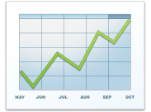
THERMOS Tool
HOW IT WORKS
THERMAL NETWORK SCENARIO DEFINITION
DATA COLLECTION & TREATMENT
THERMAL NETWORKS OPTMIZATION
Determine which thermal energy network needs to be planned or optimised
Access THERMOS tool and configure your desired thermal network
Collect the data from local sources: streets, type of building,
Built-in energy demand estimations from OpenStreetMap (OSM) or local GIS data
Automatically analyse and generate APIs to be integrated in the optimisation model
Rapid development of heat energy maps to identify energy demand/supply options
Built in network optimisation model that calculates the most efficient option
Receive personalized reports and project financial information
Notes:
THERMOS: creating a best case scenario for energy planning (pre-conditions) / conducting pre-feasibility studies
Web-based software for detailed pre-feasibility analysis of heating and cooling network options
Designed to support project development from area-wide mapping and masterplanning, through to detailed consideration of optimal network layouts.
It is a software that allows local decision makers to identify the right areas and routes for different types of thermal systems quickly and accurately by automating questions about possible system configurations and economics.

Slide 20
Who is THERMOS for...?
Local and regional authorities
Energy utilities
Investors and real estate developers
Residential, commercial and industrial customers
EU & national governments
National & regional energy agencies
Project developers and consultancies
Research and academia
Notes:
For all local energy planners and practicioners who are looking for:
Integrating local (low-carbon) energy sources to their local network
Reducing local primary energy demand, energy costs & air pollution from GHG emissions
Unlocking financing for projects and explore new business opportunities
Reducing network building and operational costs
Increase energy efficiency gains

Slide 21
...and how are we ensuring quality?
THERMOS Adoption Process – answering every day energy planning realities
THERMOS Advisory Board
THERMOS Ambassadors (selection)

Slide 22
Who was THERMOS developed with?
4 Pilot cities and 4 replicating cities….
Granollers, Spain – The municipality conducted pre-feasibility study with THERMOS to supply selected buildings in the EcoCongost industrial park with energy from local biogas production.
Replicator: Cascais, PT
Image: Granollers Mercat EPE
Islington, UK – The Islington Borough Council in London used the THERMOS tool to verify an existing feasibility study for a new heat network in the Archway neighbourhood.
Replicator: Greater London Authority, UK
Notes:
Regular twinning meetings between pilot and replication cities had been conducted to integrate practical experience from experienced pilot cities and ensure real-life needs of energy planners are met by the software’s functionalities and design.
Four training programmes with external interested participants to gather feedback and test usability from non-project stakeholders developing real world case studies with THERMOS in the process

Slide 23
Who was THERMOS developed with?
4 Pilot cities and 4 replicating cities….
Jelgava, Latvia – In Jelgava, THERMOS was used by the city and a regional energy agency to identify heat network opportunities in the residential and tertiary sectors across the city.
Replicator: Alba Iulia, RO
Image: City of Jelgava
Warsaw, Poland – The city of Warsaw applied THERMOS to connect excess heat sources to the city’s existing district heat network.
Replicator: Berlin (dena), DE
Image: Flickr / Guillaume Speurt

Slide 24
Data validation and scope of use
By default, the THERMOS’ heat demand model derives estimates of demand using building polygons from OpenStreetMap. The data was compared with real heat demands from ~30,000 buildings in Copenhagen, DK.
THERMOS can be applied to any area for which OpenStreetMap or GIS data is available.

Slide 25
THERMOS tool demonstration

Slide 26
Working with THERMOS professionally in the future
Picture: maciek905 - istock
Notes:
A software for the future, real-life need for the tool. Future of the software beyond the THERMOS project.

Slide 27
Combining a free tool with expert service
Publically available free tool open-source code​
Free Training materials
Publically funded free functionalities available on the web-based platform
Software developed with public funding will continue to be available and combined with a Software as a Service Package for premium users to maximising impact over income:
Purchasing option for special services by software experts for minimal service fees
Choose enhanced functionalities in the future based on your needs (basic & premium)
Notes:
Our goal: accelerated rollout of the right thermal networks in the right places to accelerate carbon emissions reductions.
Software was developed within the EU funded THERMOS project and thus service and subscriber fees will mainly ensure to cover running costs for maintaining and further updating the software: Maximising impact over income.

Slide 28
THERMOS user experiences

Slide 29
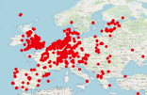
Who is using THERMOS?
Over 1050 active THERMOS users* who created 2400+ maps
OpenStreetMap contributors
* Number of active THERMOS users by Dec 2020
Notes:
More than 1000 active users developing heat maps and projects with the free version of the tool (numbers from Dec 2020)

Slide 30
Hear from THERMOS users
*Additional reviews from THERMOS users at:
https://www.thermos-project.eu/thermos-tool/user-testimony/

Slide 31
Access THERMOS

Slide 32
Explore THERMOS
Go to the THERMOS website: www.thermos-project.eu
Watch demo and training videos: https://www.youtube.com/channel/UCRKBG4T3pCrlN5Gt-8DZD6g
Explore THERMOS in your standard web browser: https://tool.thermos-project.eu/
Identify your optimal network solutions according to each of your pre-defined financial and environmental conditions

Slide 33
Contact
Center for Sustainable Energy (CSE)
St James Court, St James Parade, Bristol BS1 3LH, United Kingdom info@thermos-project.eu
Notes:
Contributing to national and international climate and energy targets

Slide 34
Notes:
THERMOS project: 2016-2021

